Slide 1
Object Orientated Paradigm C++ Programming
Further Concepts

Slide 2
From the SDD syllabus
concepts
– classes
– objects
– attributes
– methods/operations
– variables and control structures
– abstraction
– instantiation
– inheritance
– polymorphism
– encapsulation

Slide 3
Review
Data Abstraction: The reduction of a particular body of data to a simplified representation of the whole.
That is, designing classes so they are reduced to their necessary attributes and methods.

Slide 4
Inheritance
In terms of OOP, what is inheritance?
Inheritance is the capability of one class to acquire properties and characteristics from another class. The class whose properties are inherited by other class is called the Parent or Base or Super class. The class which inherits properties of another class is called Child or Derived or Sub class.
Inheritance makes the code reusable. When we inherit an existing class, all its methods and fields become available in the new class, hence code is reused.
Except for ??????? attributes and methods

Slide 5
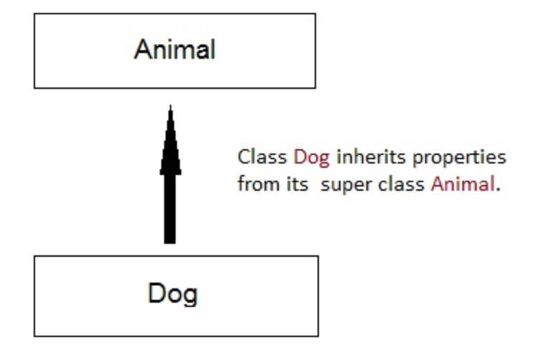
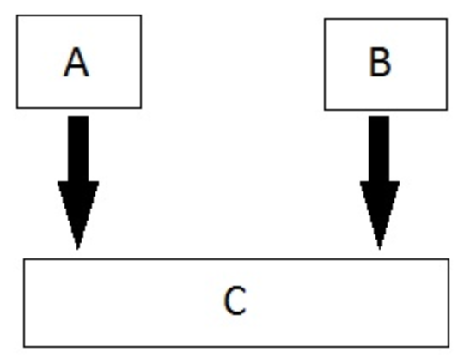
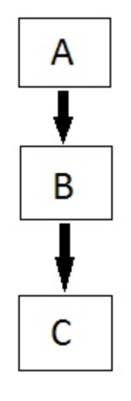
Different types of inheritance
Single Inheritance
Multiple Inheritance
Multi level Inheritance

Slide 6
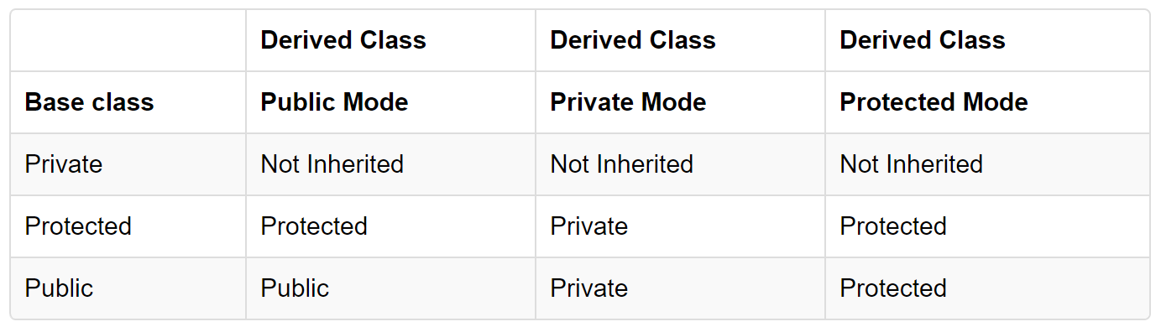
Summary of inheritance visibility or scope

Slide 7
Constructors and inheritance
Base class constructors are always called in the derived class constructors.
Whenever you create derived class object, first the base class default constructor is executed and then the derived class's constructor finishes execution.

Slide 8
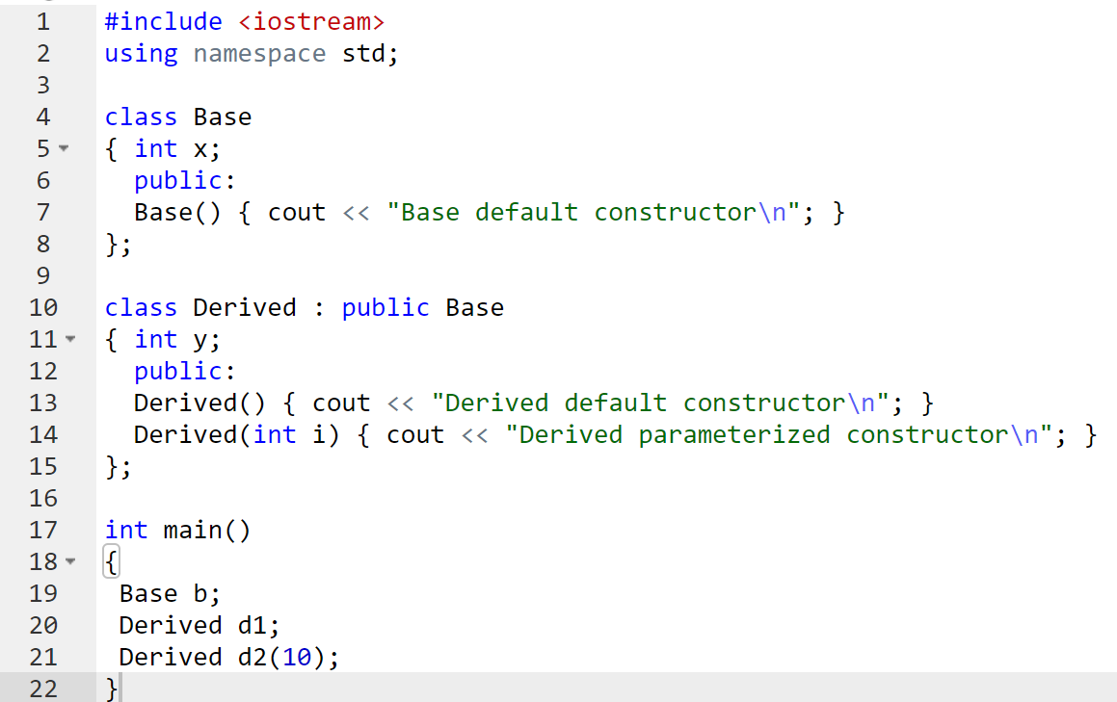
Example
When d1 is instantiated, class Base constructor is called printing “ Base default constructor”.
When d2 is instantiated, class Base constructor is called printing “ Base default constructor”.
The constructor for class Derived is then called printing “Derived default constructor”
The constructor for class Derived is then called printing “Derived default constructor”
The constructor for class Derived(int i) is then called printing “Derived parameterized constructor”

Slide 9
Why are base constructors called?
Constructors have a special job of initializing the object properly.
A Derived class constructor has access only to its own class members, but a Derived class object also have inherited property of Base class, and only base class constructor can properly initialize base class members. Hence all the constructors are called, or else object wouldn't be constructed properly.

Slide 10
Polymorphism
Means having multiple forms of one thing.
In inheritance, polymorphism is done by method overriding, when both a super and sub class have a member function with same declaration but a different definition.
If we inherit a class into the derived class and provide a definition for one of the base class's function again inside the derived class, then that function is said to be overridden, and this mechanism is called Function Overriding

Slide 11
C++ requirements for function overriding
Inheritance should be there. Function overriding cannot be done within a class. For this we require a derived class and a base class.
Function that is redefined must have exactly the same declaration in both base and derived class, that means same name, same return type and same parameter list.
Note in the HSC and the textbook, they also use Function Overloading as polymorphism

Slide 12
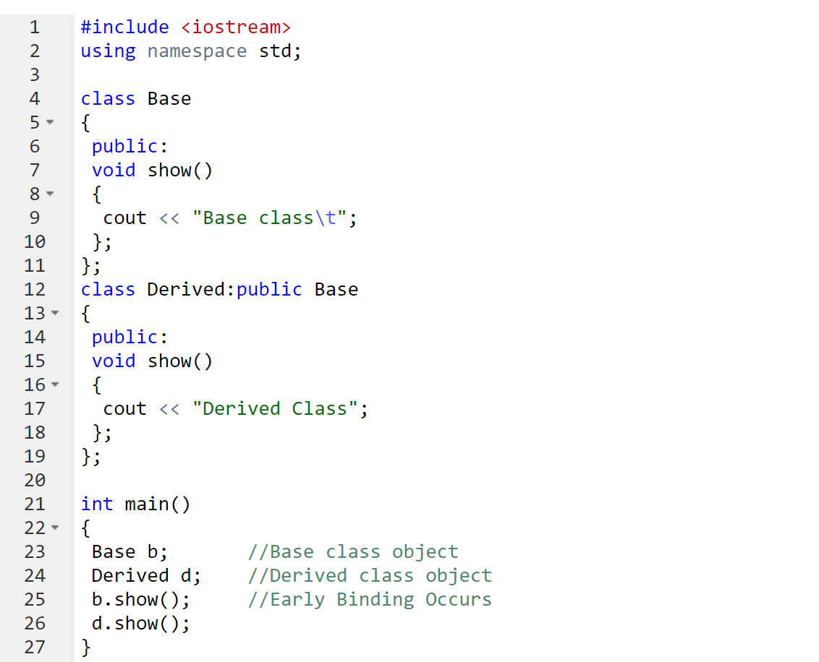
Example: Function Overriding
In the above example, we are calling the overrided function show using Base class and Derived class object. Base class object will call the Base version of the function and Derived class's object will call the Derived version of the function.

Slide 13
Function Overloading
If any class has multiple functions with same names but different parameters then they are said to be overloaded.
Function overloading is usually used to enhance the readability of the program. If you have to perform one single operation but with different number or types of arguments, then you can simply overload the function.

Slide 14
How to overload a function
By changing number of Arguments.
By having different types of argument.

Slide 15
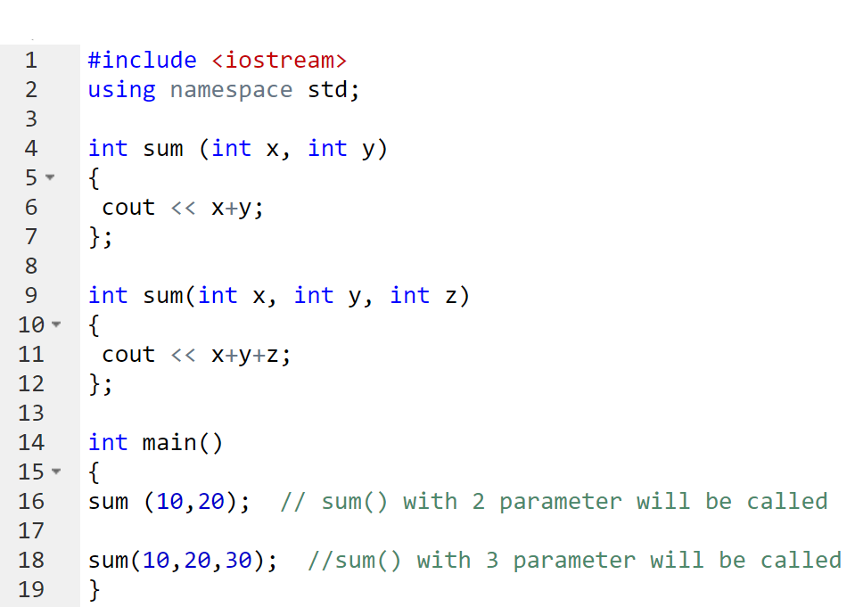
Examples of function overloading – different number of arguments
In this type of function overloading we define two functions with same names but different number of parameters of the same type.
For example, here we have made two sum() functions to return the sum of two and three integers.

Slide 16
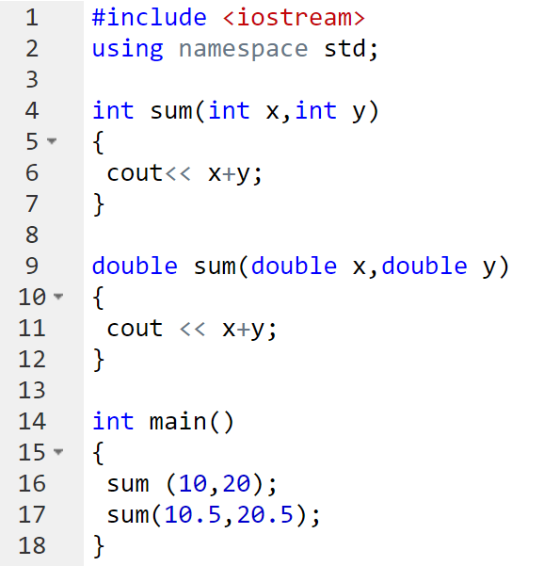
Examples of function overloading – different argument datatypes
In this type of overloading we define two or more functions with same name and same number of parameters, but the type of parameter is different.
For example in this program, we have two sum() function, first one gets two integer arguments and second one gets two double arguments.

Slide 17
Encapsulation
Encapsulation is an Object Oriented Programming concept that binds together the data and functions that manipulate the data, and that keeps both safe from outside interference and misuse. Data encapsulation led to the important OOP concept of data hiding.
Data encapsulation is a mechanism of bundling the data, and the functions that use them.

Slide 18
Encapsulation (cont)
C++ supports the properties of encapsulation and data hiding through the creation of user-defined types, called classes. We already have studied that a class can contain private, protected and public members. By default, all items defined in a class are private.
To make parts of a class public (i.e., accessible to other parts of your program), you must declare them after the public keyword. All variables or functions defined after the public specifier are accessible by all other functions in your program.
The getter and setting sample program is a good example of encapsulation and data hiding.

